Slide 1
Zen of Data
Day 1
The Data Bootcamp |
October 2017

Slide 2
Quick Introductions! (30 seconds)
Name
Where From?
Background (Career, Education, Interests)
Why are you here?

Slide 3


Our All-Star TAs
WE CANT WAIT TO HELP YOU GUYZZZ!
Ted Markulin
Brandon Simon

Slide 4


Instructor = ... ?
Jeremy Hill
Senior Curriculum Engineer at Trilogy Education Services

Slide 5

Things I’ve Worked On…

Slide 6
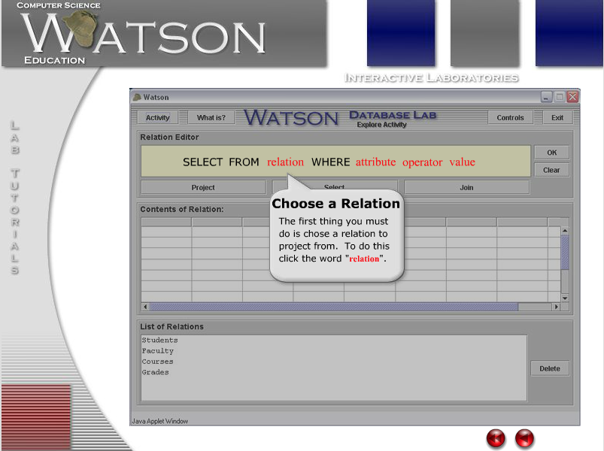
Things I’ve Worked On…

Slide 7

Things I’ve Worked On…

Slide 8
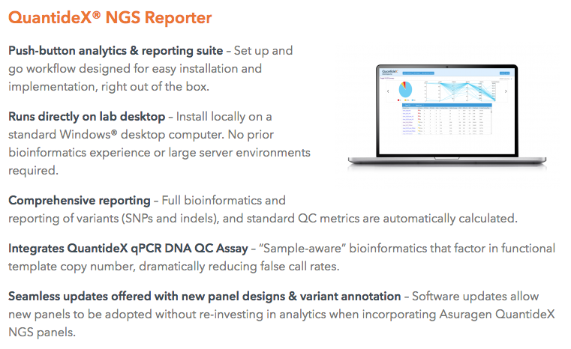
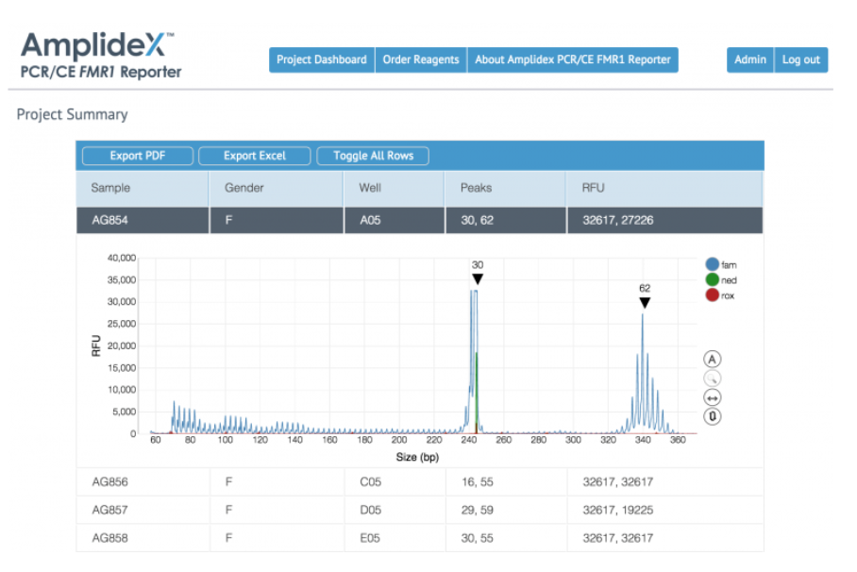
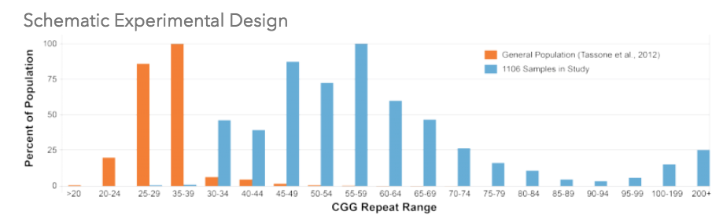
Things I’ve Worked On…

Slide 9
Your Goals
Notes:
It’s important to keep in mind why you joined this class. Let’s talk about your goals.

Slide 10
Take 3 minutes and write down you top 3 goals for this course. * Star your top goal * Submit your top goal to the poll

Slide 11
The Buddy System
Notes:
It’s important to keep in mind why you joined this class. Let’s talk about your goals.

Slide 12
For every class and every activity, you should have a buddy to work with.
If your buddy is stuck on an activity then help them out
If you are stuck then ask your buddy
If you are both stuck then grab an Instructor or TA for help

Slide 13
The Rise of Data
Notes:
It’s important to keep in mind why you joined this class. Let’s talk about your goals.

Slide 14
Question: Why is “data” such a hot skill these days?

Slide 15
1. Explosive Growth in “Digitized” Data (Creation)

Slide 16
2. Explosive Growth in Analytic Tools (Synthesis)

Slide 17
3. Accelerating Search for Actionable Insight (Value)

Slide 18
Data Means What?
Notes:
It’s important to keep in mind why you joined this class. Let’s talk about your goals.

Slide 19
So… What is data science?

Slide 20
First Thoughts…

Slide 21
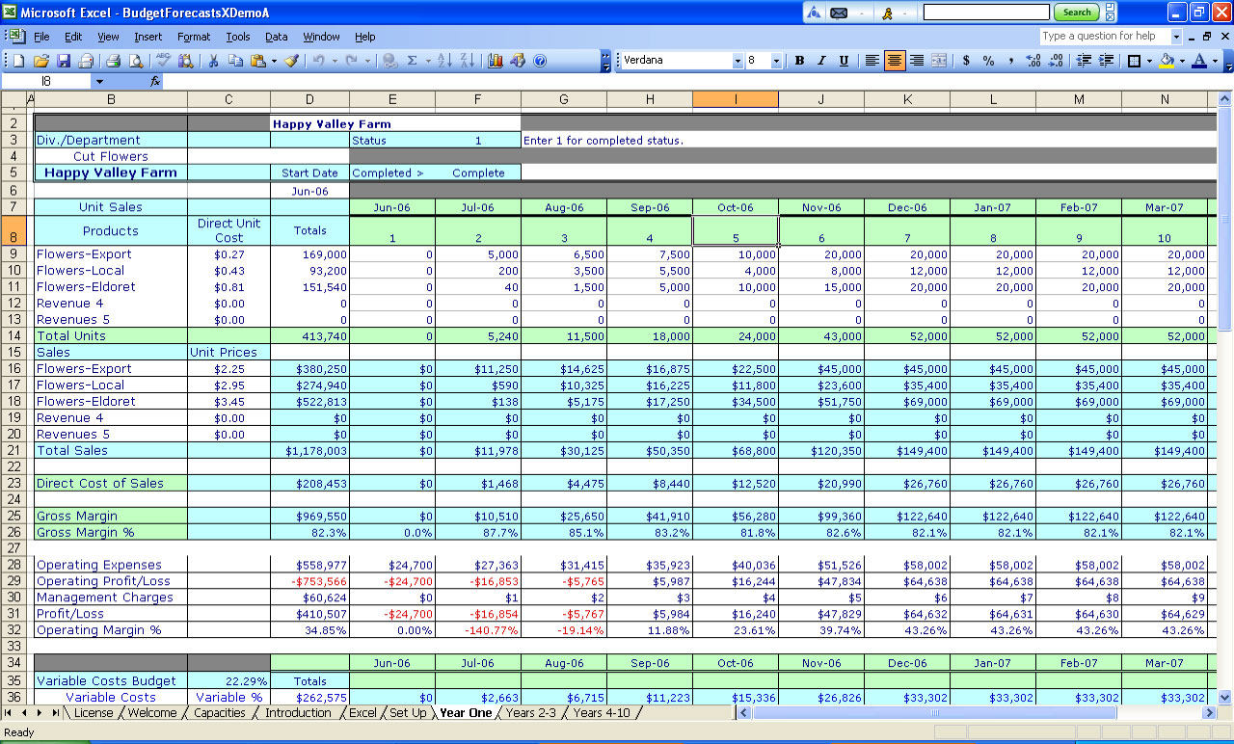
First Thoughts…

Slide 22

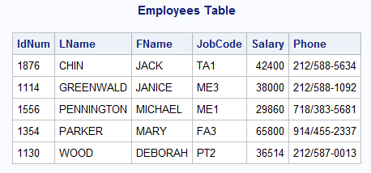
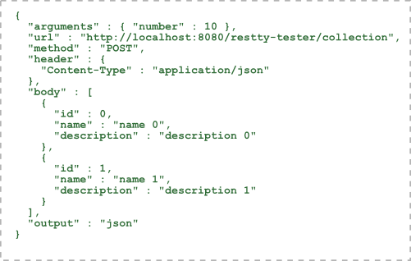

First Thoughts…

Slide 23
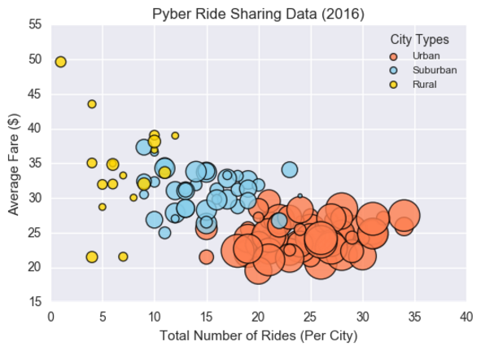
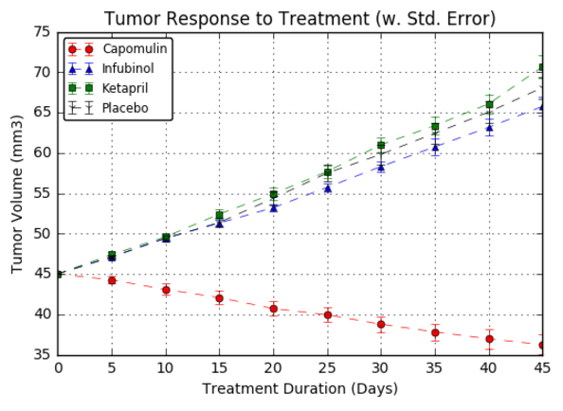

First Thoughts…

Slide 24
Data Science centers on two things:

Slide 25
Truth-Telling & Story Telling

Slide 26
Truth-Telling

Slide 27
Data As… Truth-Telling
Unearthing relationships

Slide 28
Data As… Truth-Telling
Making Predictions

Slide 29
Data As… Truth-Telling
Stating Significance

Slide 30
Story-Telling

Slide 31
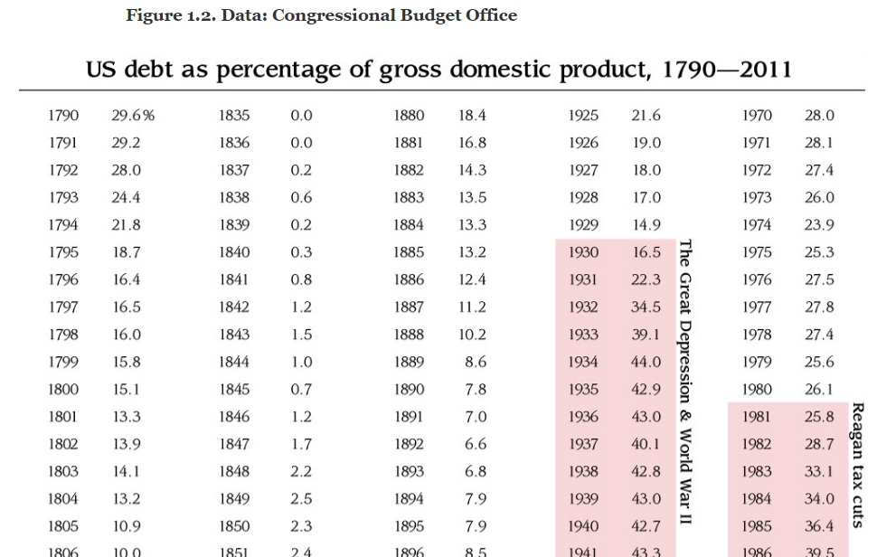
Data As… Story-Telling

Slide 32
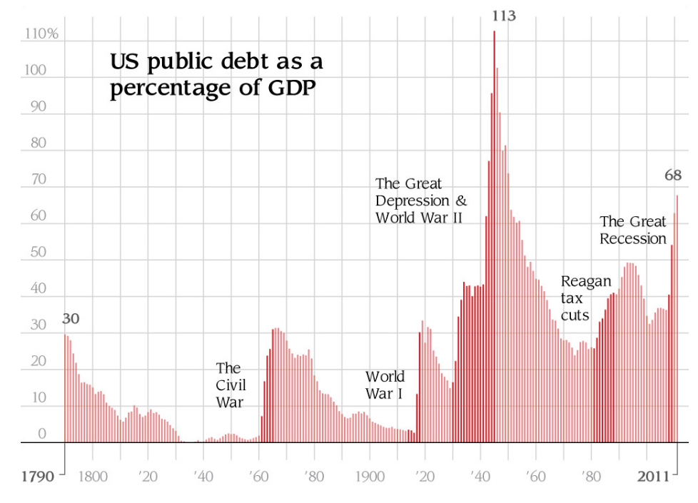
Data As… Story-Telling

Slide 33
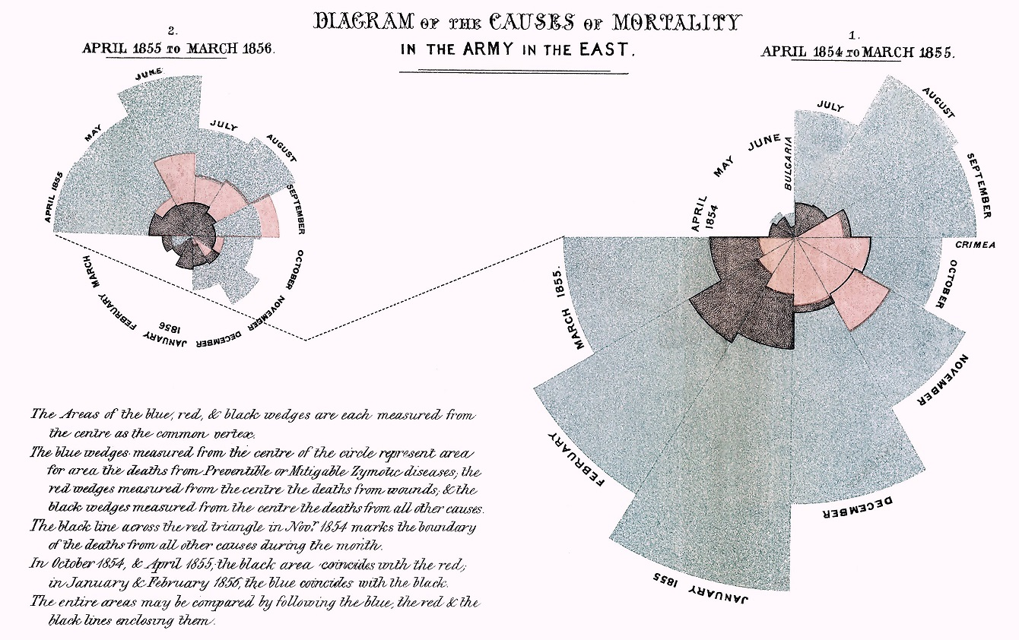
Data As… Story-Telling

Slide 34
Data As… Story-Telling
Data = Drama

Slide 35
Course Overview
Notes:
It’s important to keep in mind why you joined this class. Let’s talk about your goals.

Slide 36
Tools for Truths, Skills for Stories…
Our Goals
Truth-Telling
Story-Telling
Our Means
Microsoft Excel
Python
Pandas
Tweepy
VADER
Matplotlib
APIs
Beautiful Soup
Machine Learning
MySQL
MongoDB
HTML / CSS
JavaScript
D3.js
Leaflet.js / Google Maps
CartoDB
Tableau
Hadoop

Slide 37
Daily Routine
For each class we’ll run through the following:
Set Objectives
Brief Background Lecture
Watch Me / Coding Demos
Code Discussions
In-Class Exercises
Project Work

Slide 38
Daily Routine
For each class we’ll run through the following:
Set Objectives
Brief Background Lecture
Watch Me / Coding Demos
Code Discussions
In-Class Exercises
Project Work
The Super Important Stuff!!!
i.e. Always be doing!

Slide 39
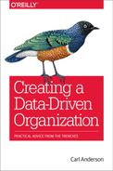
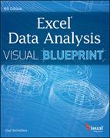





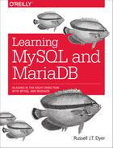


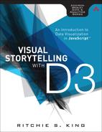

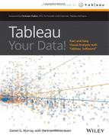


Curriculum At-A-Glance
Weeks 1-2: Intro to Data Analytics & Excel Masters Students begin the course with an introduction to the high-level concepts of data analytics and real-world data crunching with Excel Formulas, Pivot Tables, and Conditional Formatting.
Weeks 3-9: Python Data Analytics and Visualization Next, students are given a thorough crash-course on Python programming, followed by multiple weeks of data processing using advanced libraries like NumPy, Pandas, Matplotlib, Tweepy, and Beautiful Soup.
Weeks 10-12: Deep Dive into Databases Students then immerse themselves in three-weeks of introductory and advanced work with SQL (MySQL and SQLAlchemy) and noSQL databases (MongoDB).
Weeks 13-17: Web Based Data Visualization Students then complete a series of rigorous weeks introducing them on the fundamental tools of web-development (HTML, CSS, JavaScript) and advanced libraries useful for data visualization (D3.js, Leaflet.js)
Weeks 20-24: Final Projects & Advanced Topics
Finally, students complete the program by developing a “real-world” data visualization project that applies all they’ve learned. During this time student will be introduced to advanced topics like Tableau, Hadoop, Machine Learning, and R.

Slide 40
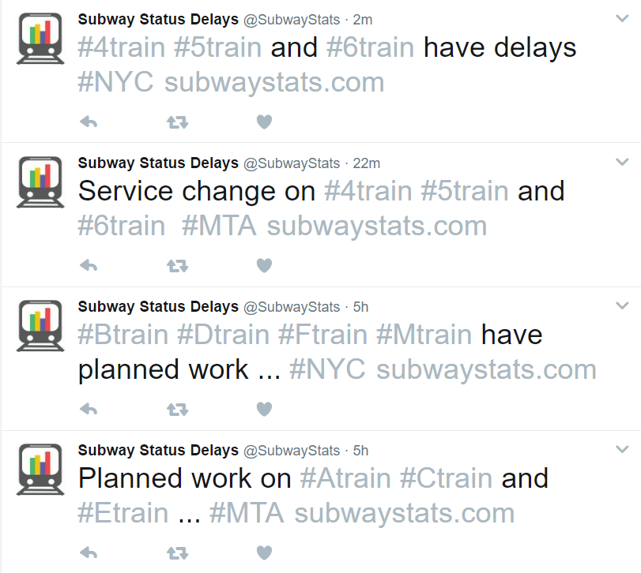
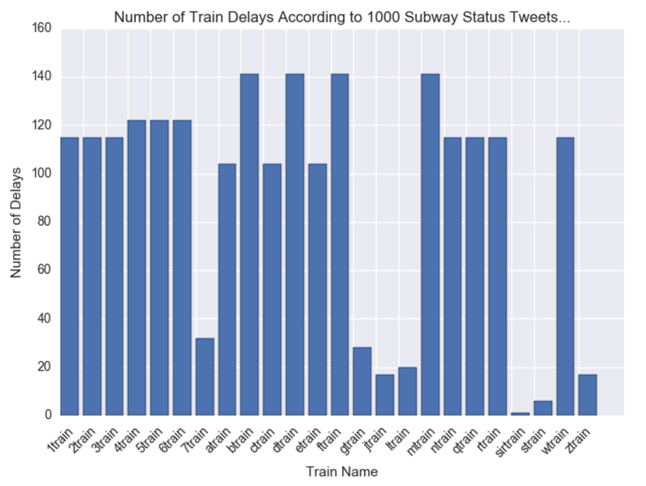
Example Activity: Subway Delays… According to Twitter
We’ll utilize Twitter Data online to assess which NYC trains are most likely to be delayed. We will be using Python Pandas, Tweepy, Twitter’s API, and Matplotlib to convert tweet data into meaningful graphs.

Slide 41
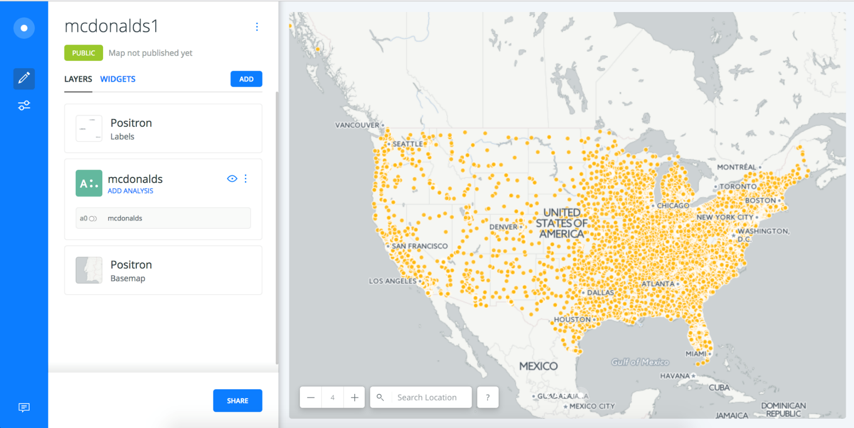
Example Activity: McDonalds Map (Carto)
We’ll be using publicly available data to create interactive dashboards of all McDonalds across the country using easy-to-use visualization tools like Carto.

Slide 42

Example Activity: Banking Deserts
And we’ll be using a variety of public demographic data and APIs to explain many real-world social phenomena.

Slide 43
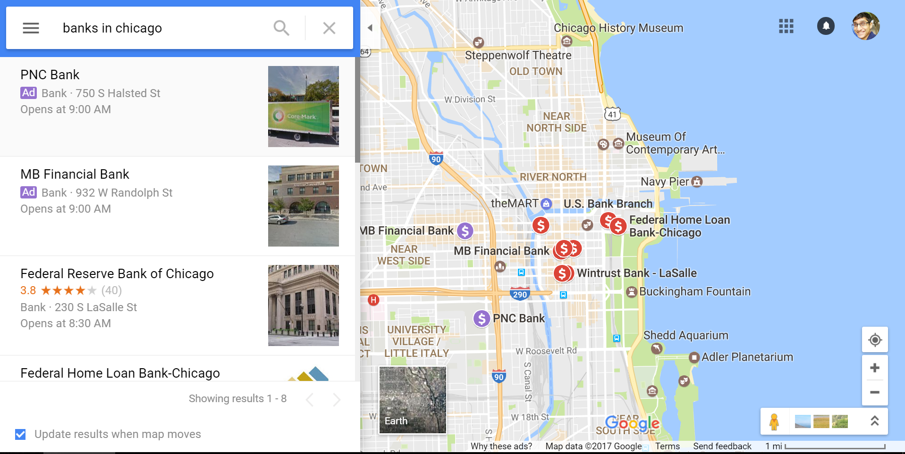

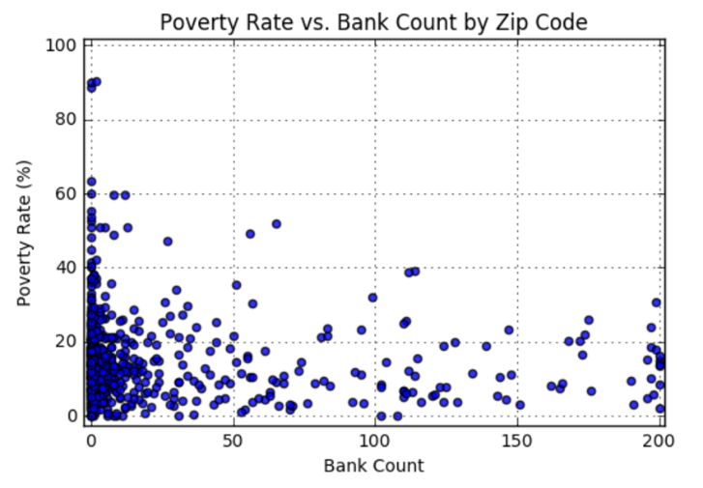
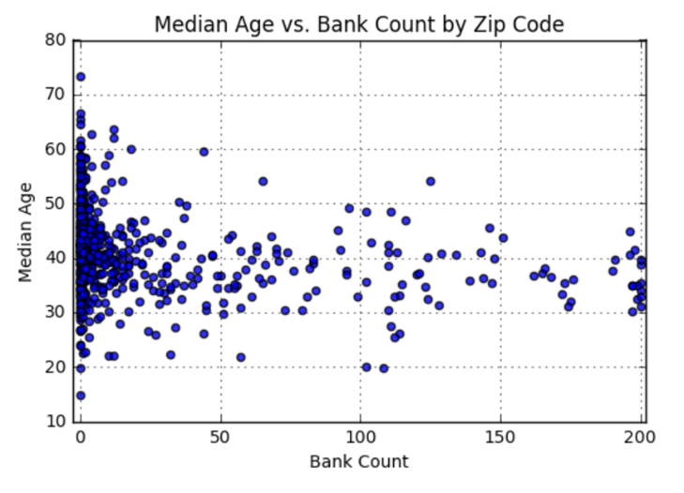
Example Activity: Banking Deserts
We’ll be utilizing data from sources like the US Census, Google Maps, and more to dredge out insights on poverty, discrimination, and the impact of changing economies.

Slide 44
We’ve got a long ways to go…

Slide 45
Helpful Tips
Notes:
It’s important to keep in mind why you joined this class. Let’s talk about your goals.

Slide 46

1. Embrace Your Inner Toddler
This should be you.

Slide 47

2. Brace Yourself for Doubt, Challenge, and Confusion

Slide 48
2. Brace Yourself for Doubt, Challenge, and Confusion
“You can’t tell whether you’re learning something when you’re learning it—in fact, learning feels a lot more like frustration.”
“What I’ve learned is that during this period of frustration is actually when people improve the most, and their improvements are usually obvious to an outsider. If you feel frustrated while trying to understand new concepts, try to remember that it might not feel like it, but you’re probably rapidly expanding your knowledge.”
Jeff Dickey, Author of Write Modern Web Apps with the MEAN Stack: Mongo, Express, AngularJS, and Node.JS

Slide 49
3. Relish the Novice Experience
Expect a lot of lightbulb moments

Slide 50
4. Form a Community Now!
Your
Classmates

Slide 51
5. Put in the Hours (And the Effort)!
There is no “magic pill”. You’ve got to put in the hours!

Slide 52
6. Celebrate Your Successes!

Slide 53
It’s time for a group activity!

Slide 54
Form a group of 4 students
Facilitator – Keeps all group members involved and generates discussion
Record Keeper – Documents and Writes down all points that will be presented
Timekeeper – Responsible for time checkpoints (halfway and 1 minute left)
Relayer – Shares the group’s information with the class

Slide 55
Break!
Notes:
It’s important to keep in mind why you joined this class. Let’s talk about your goals.

Slide 56
Thought Experiment #1
The Great Debate
Notes:
It’s important to keep in mind why you joined this class. Let’s talk about your goals.

Slide 57
Imagine… Your entire bonus rests on answering this next question.

Slide 58
Or if you want something higher stakes... Imagine Your entire life depends on answering this question…

Slide 59


The Question…
Which do Americans prefer:
Italian or Mexican food?

Slide 60
> YOUR TURN!
Activity: The Great Debate | Suggested Time: 15 min
Assignment:
With your group develop a complete strategy for answering this question with as much confidence possible. Specifically, answer questions like:
What data will you attempt to gather?
What relationships will you be looking for?
How will you ensure your answer is most likely “true”?
Assumptions:
You are given 5 hours and a budget of $10 to accomplish this.
Your answer will be tested by randomly selecting 9 Americans who will each be asked the question – with 0 qualifiers.
You only have your team.
Be prepared to share! (P.S. Your answer had better not be: “We Googled it”)

Slide 61
Thought Experiment #1
The Great Debate (Analyzed)
Notes:
It’s important to keep in mind why you joined this class. Let’s talk about your goals.

Slide 62
Step 1: Decompose the Ask

Slide 63
Step 1: Decompose the “Ask”
Which do Americans prefer:
Italian or Mexican food?

Slide 64
Step 1: Decompose the “Ask”
Which do Americans prefer:
Italian or Mexican food?

Slide 65
Step 1: Decompose the “Ask”
Which do Americans prefer:
Italian or Mexican food?
Questions it Raises:
Who exactly is an American?
Are Americans just white, forty-year old males?
Do Americans just live in big cities?
Are Americans just millennials?
Obviously not. So, how can we get a representative sample of Americans?

Slide 66
Step 1: Decompose the “Ask”
Which do Americans prefer:
Italian or Mexican food?

Slide 67
Step 1: Decompose the “Ask”
Which do Americans prefer:
Italian or Mexican food?
Questions it Raises:
How do we define “preference”?
Do people prefer the foods they eat most frequently?
Do people prefer the foods they wish they could eat if cost was not an issue?
How uniform is the preference? Is it regionalized? Is it different by demographic?
Inherently, preference is subjective. We are going to need to make it objective.

Slide 68
Step 1: Decompose the “Ask”
Which do Americans prefer:
Italian or Mexican food?

Slide 69
Step 1: Decompose the “Ask”
Which do Americans prefer:
Italian or Mexican food?
Questions it Raises:
How do we categorize foods? Is Pizza Italian? Is Taco Bell Mexican?
How do we categorize food? Does making pasta at home constitute Italian? Or are we just talking about restaurants?
Are we just talking about “best experiences?” Or are we including poorer renditions of these foods?
These are broad categories we are pursuing. We will have to narrow the scope.

Slide 70
Step 2: Identify Data Sources

Slide 71
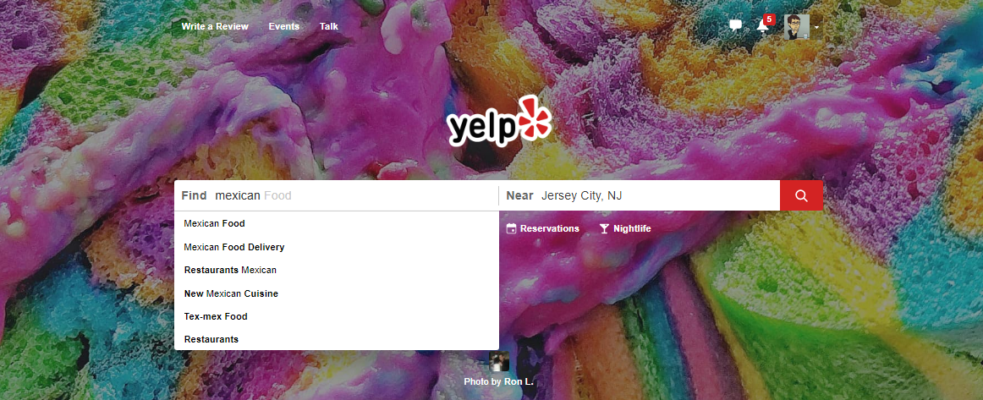
Step 2: Identify Data Sources
As everyday consumers, we are regularly getting a pulse of everyday American food preferences to inform our own decisions. Perhaps we can make use of the same approach?

Slide 72
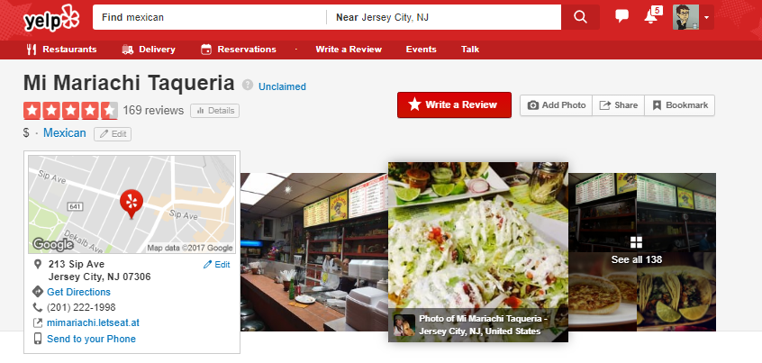
Step 2: Identify Data Sources
Accessing a web service like Yelp provides an almost encyclopedic amount of information on the eating preferences of Americans.

Slide 73

Step 2: Identify Data Sources
Why poll an audience, when there already exist enormous databases of information on American food preferences – readily available online?

Slide 74
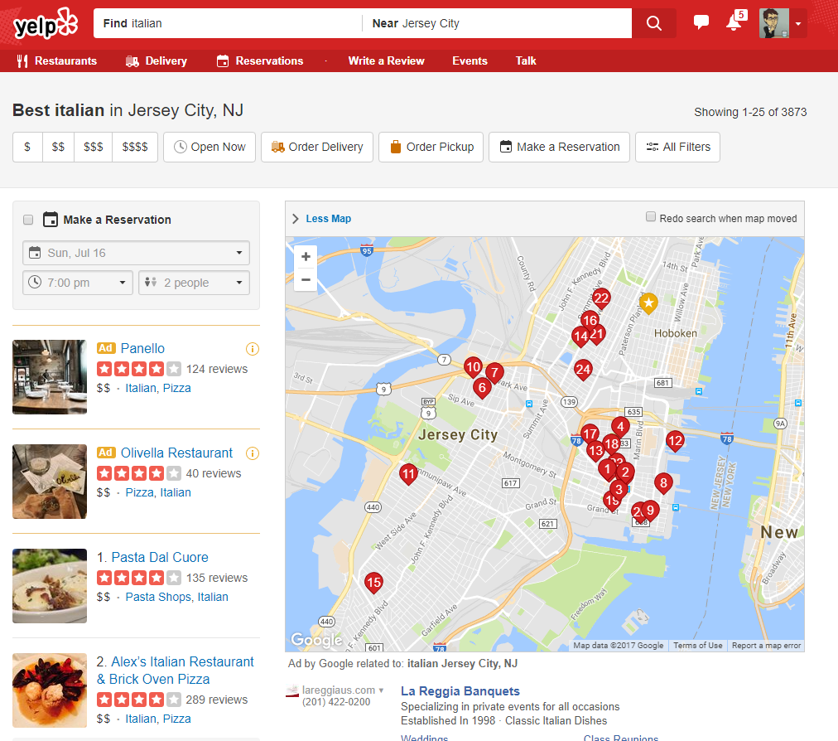
Step 2: Identify Data Sources
Food Type
Location
And LOTS of Data!!
Review Counts
Ratings
Thank you Yelp!!!!

Slide 75
Step 3: Define Strategy and Metrics

Slide 76
Step 3: Define Strategy and Metrics
Here we created a blueprint for what we’re targeting:
Americans:
Ideally we need thousands of records from Americans in hundreds of different cities. (Large samples)
Preference:
Number of Yelp Reviews (More = Preference)
Average Aggregated Ratings (Higher = Preference)
Italian and Mexican Food:
Top 20 Italian and Mexican restaurants in every city.

Slide 77
Step 3: Define Strategy and Metrics
New York
Tucson, AZ
Washington, DC
Italian
Mexican
Italian
Mexican
Italian
Mexican
Restaurant
Restaurant
Restaurant
Restaurant
Restaurant
Restaurant
Restaurant
vs
Restaurant
Restaurant
vs
Restaurant
Restaurant
vs
Restaurant
Restaurant
Restaurant
Restaurant
Restaurant
Restaurant
Restaurant
Restaurant
Restaurant
Restaurant
Restaurant
Restaurant
Restaurant
Restaurant
Restaurant
Restaurant
Restaurant
Restaurant
Restaurant
Omaha, NE
San Diego, CA
Atlanta, GA
Italian
Mexican
Italian
Mexican
Italian
Mexican
Restaurant
Restaurant
Restaurant
Restaurant
Restaurant
Restaurant
Restaurant
Restaurant
Restaurant
Restaurant
Restaurant
vs
Restaurant
vs
Restaurant
vs
Restaurant
Restaurant
Restaurant
Restaurant
Restaurant
Restaurant
Restaurant
Restaurant
Restaurant
Restaurant
Restaurant
Restaurant
Restaurant
Restaurant
Restaurant
Restaurant
Restaurant
Repeat this analysis for as many cities as possible…

Slide 78
Step 4: Build Data Retrieval Plan

Slide 79

Step 4: Data Retrieval Plan
We could brute force our way to retrieve this data, but…
It would be extremely time consuming
It would be skewed by our city familiarity
It would be manually labor intensive

Slide 80
Step 4: Data Retrieval Plan
Basically… Not in a million years.

Slide 81
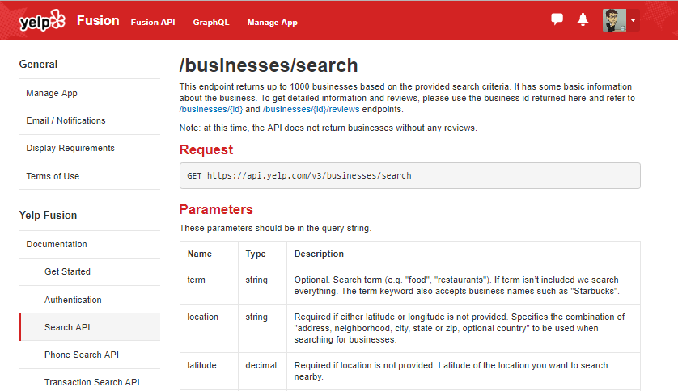
Thank You Yelp!
Thankfully, we can take advantage of the Yelp Fusion API to programmatically run our queries. (#ThankGodForProgramming)

Slide 82
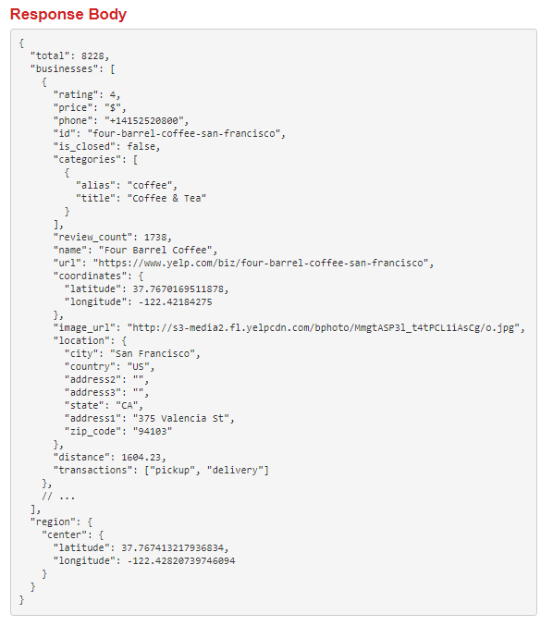

Thank You Yelp!
Thankfully, we can take advantage of the Yelp Fusion API to programmatically run our queries. (#ThankGodForProgramming)

Slide 83


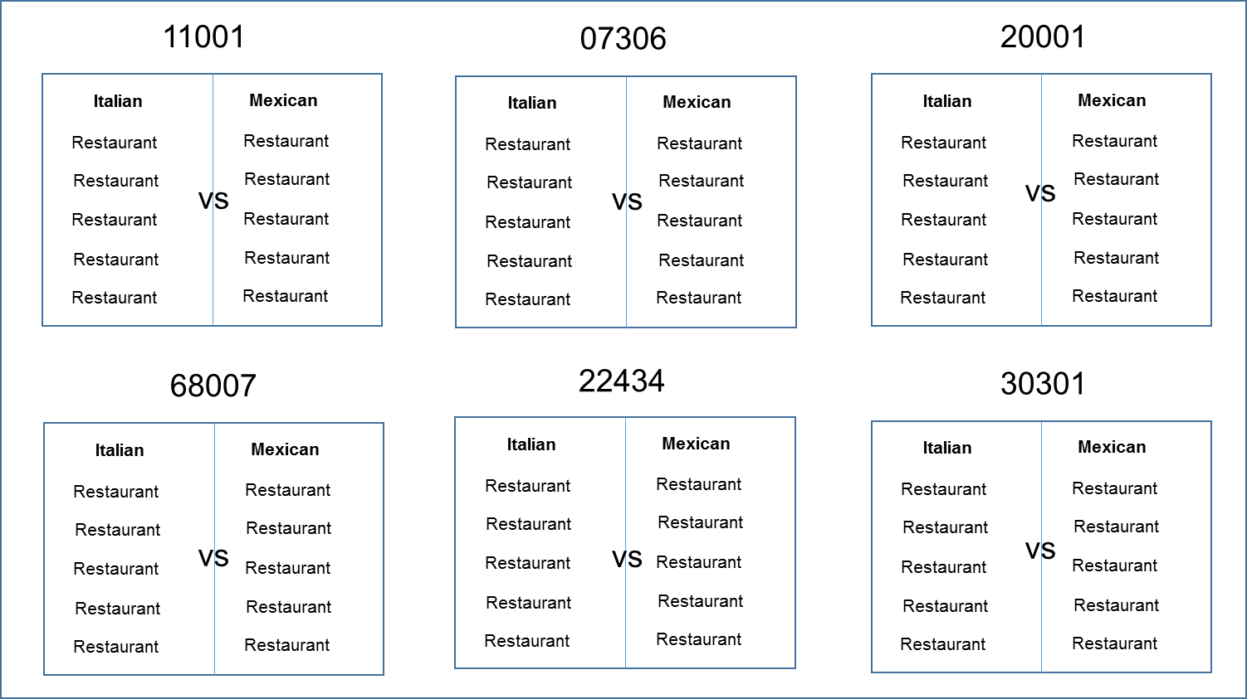

Step 4: Build Data Retrieval Plan
We will build a Python script to randomly select over 700 zip codes from the US Census and then acquire review data from the top 20 Mexican and Italian restaurants for each zip codes using the Yelp API.

Slide 84
Step 5: Retrieve the Data

Slide 85


Pulling with Python
Randomly Select a Zip Code
Create an API Request
Save the Output to a Data Frame

Slide 86
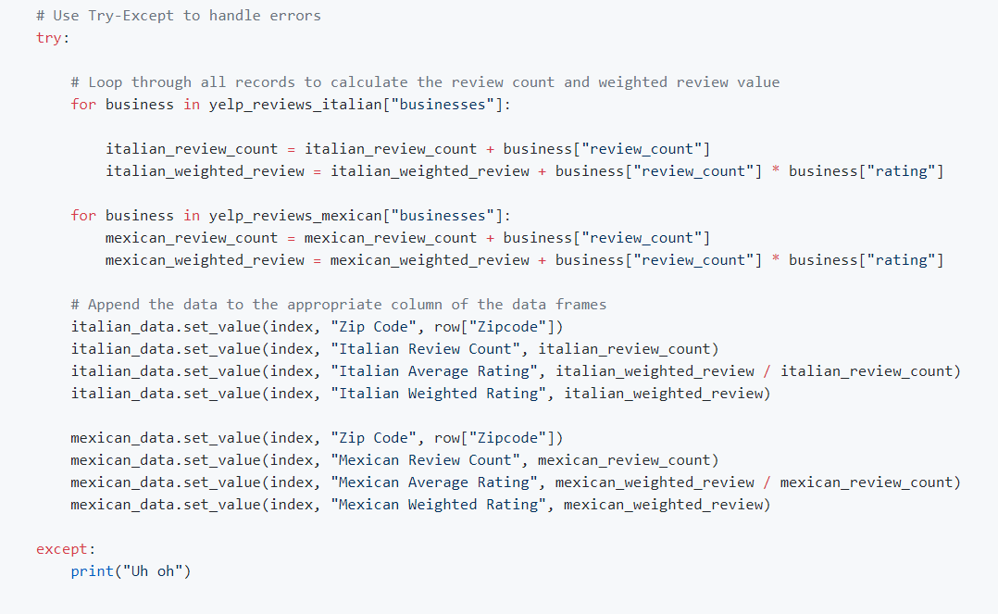
Pulling with Python
This funky code…

Slide 87
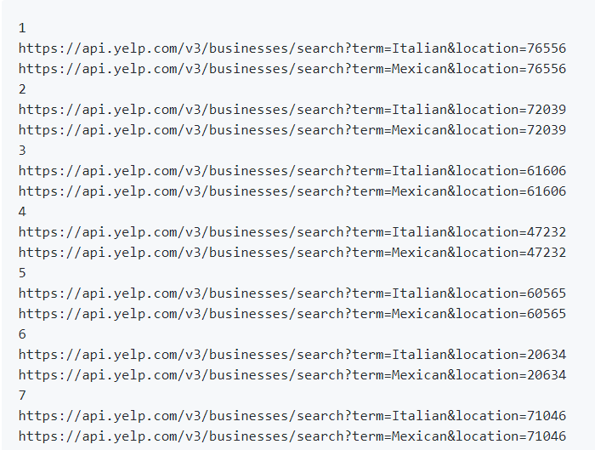
Pulling with Python
Will make all these URLs

Slide 88
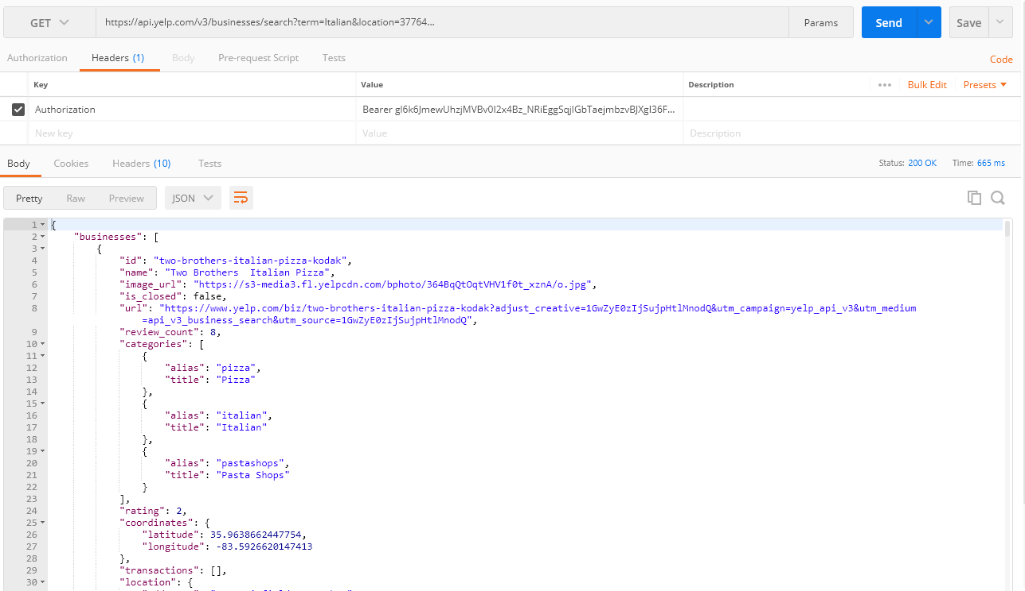
Pulling with Python
And each of these URLs holds a piece of our answer…

Slide 89
Step 6: Assemble and Clean the Data

Slide 90
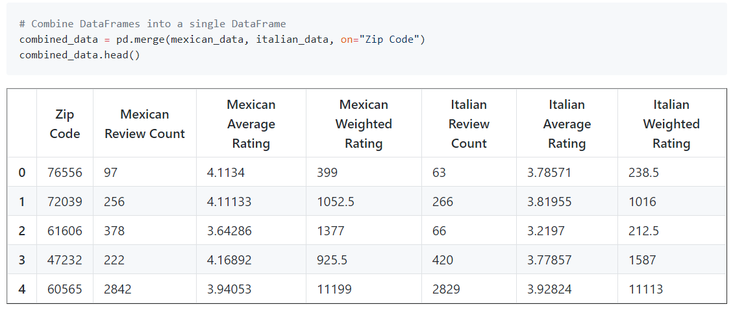
Cleaning with Pandas
No data comes out intrinsically the way you want it to.
In our case, we needed multiple steps to aggregate the data along our channels of interest.

Slide 91
Step 7: Analyze for Trends

Slide 92
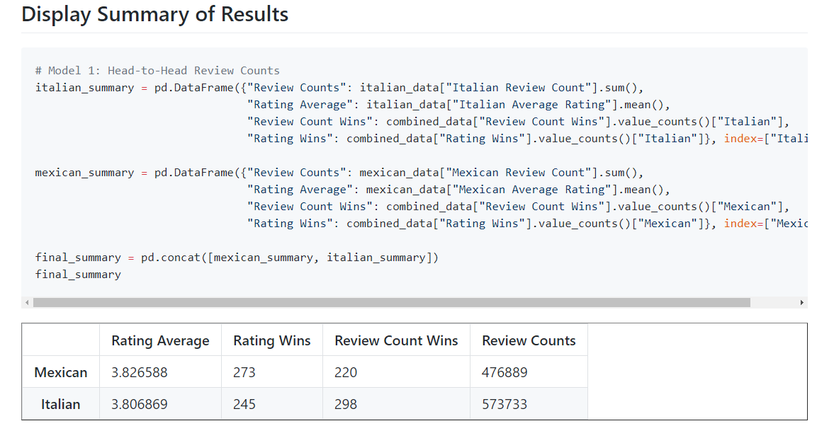
Analyze for Trends (Table)
Ugh..
It’s Close.

Slide 93
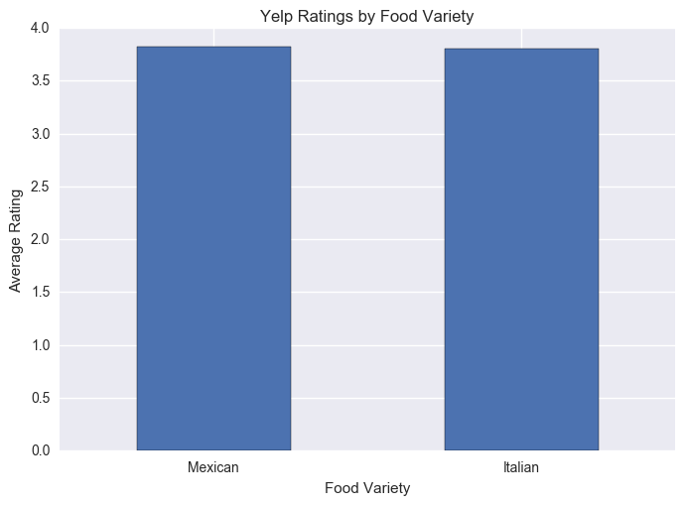
Analyze for Trends (Ratings)
Yelpers Rate Italian and Mexican relatively equally.

Slide 94
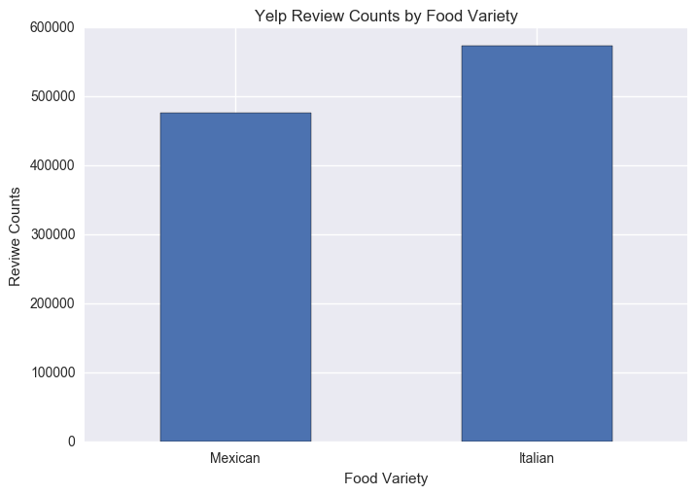
Analyze for Trends (Review Counts)
But… Yelpers seem to significantly review more Italian restaurants.

Slide 95
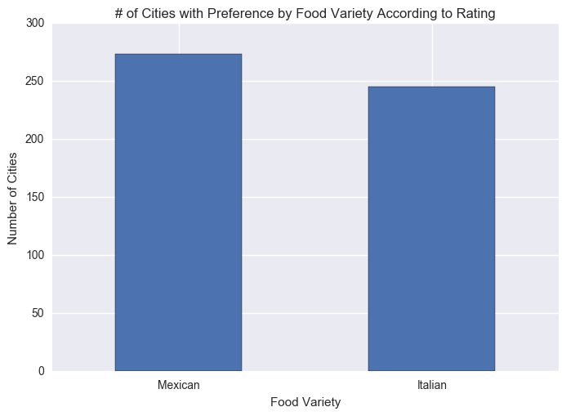
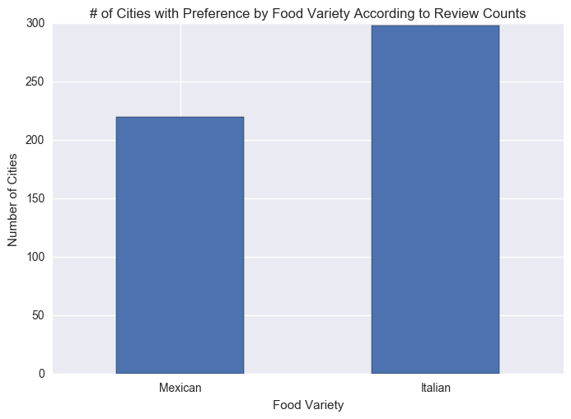
Analyze for Trends (Winner Take All)
Just for kicks I threw in an analysis to ask based on aggregating the data along cities using a “Winner-Take-All” approach.
It’s sort of a wash.

Slide 96
Analyze for Trends (Statistical Analysis)
Metric | Italian | Mexican | p-Value (T-Test)
Average Rating | 3.806 | 3.826 | 0.284
Review Counts | 573k | 476k | 0.057
Because of how close the numbers appear, we utilized a Student’s T-Test to quickly asses if the perceived differences are statistically significant.
The difference in review count is statistically significant.

Slide 97
Step 8: Acknowledge Limitations

Slide 98
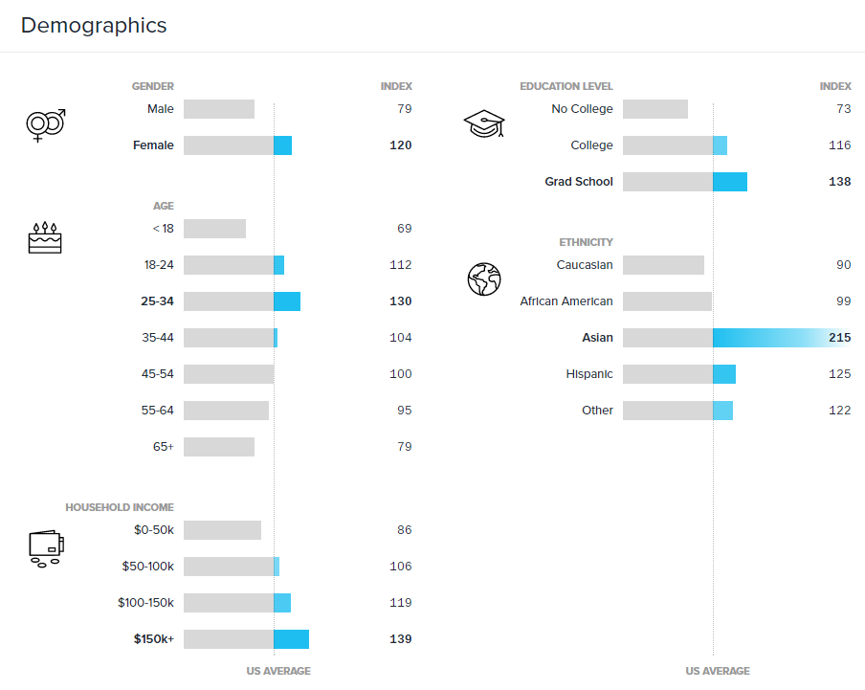
Limitations in Analysis
Yelp demographics may not match the American demographic.

Slide 99
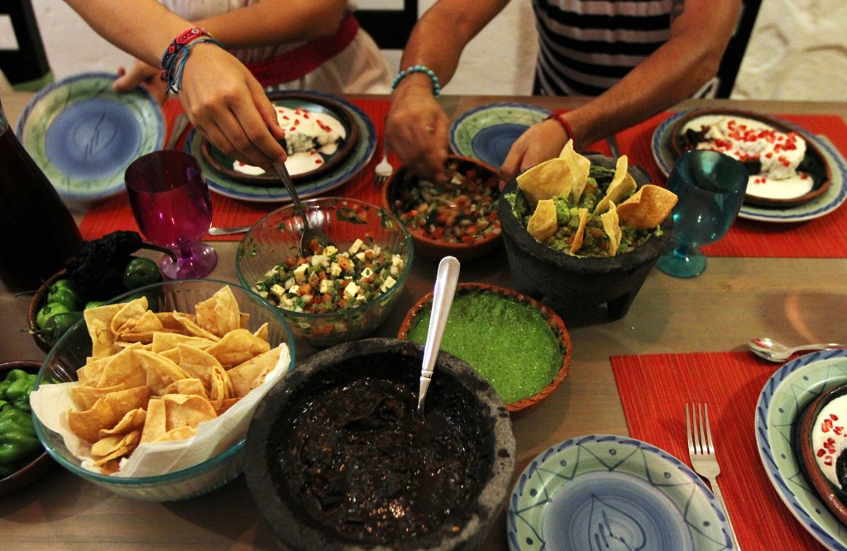

Limitations in Analysis
Restaurant experiences do not equate to home cooked meals.

Slide 100

Limitations in Analysis
“Fine” dining effect?

Slide 101
Step 9: Make the Call

Slide 102
Making the Call
The “Proper” Conclusion:
“Based on our analysis, it is clear that the American preference for Italian and Mexican food are similar in nature. As a whole, Americans rate Mexican and Italian restaurants at statistically similar scores (Avg. score: 3.8, p-value: 0.285). However, there exists statistically significant evidence that Americans write more reviews of Italian restaurants than Mexican (+96k, p-value: 0.057). This may indicate that there is an increased interest in visiting Italian restaurants at an experiential level. However, it may also merely suggest that Yelp users enjoy writing reviews on Italian restaurants more than Mexican restaurants.”

Slide 103
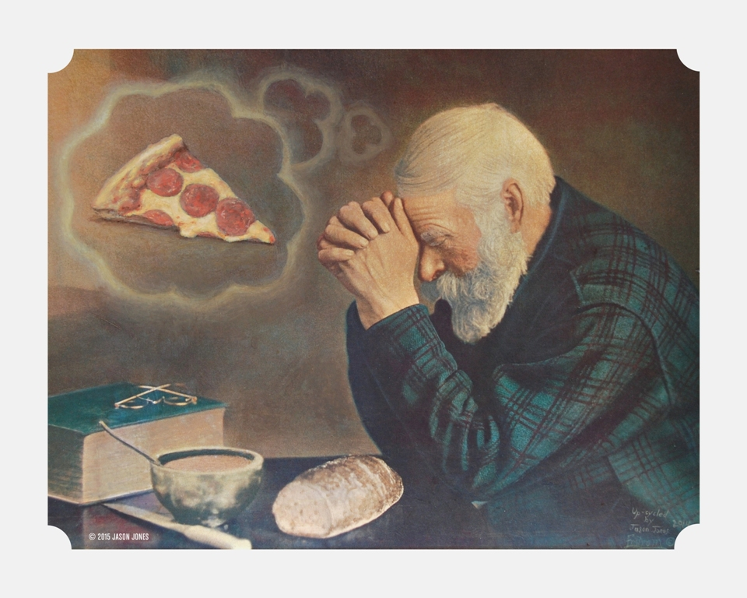
Making the Call
The “Let’s Be Real” Conclusion:
Italian.
(But it’s going to be close…)

Slide 104
> YOUR TURN!
Activity: Analyze the Code | Suggested Time: 10 min
Assignment:
Take a few moments to analyze the code provided over slack. Talk to the people in your group and try to dissect as much (or as little) as you can.
If you are new to coding, your goal should be to understand what a single line does.
If you are not new to coding, your goal should be to understand the overall flow of activities.
Take a moment to explain what you’ve learned to the people around you.

Slide 105

Freaked Out a Bit?
It’s okay!

Slide 106
An Analytics Paradigm
Notes:
It’s important to keep in mind why you joined this class. Let’s talk about your goals.

Slide 107
Analytics Paradigm
Decompose the Ask
Identify Data Sources
Define Strategy and Metrics
Build Data Retrieval Plan
Retrieve the Data
Assemble and Clean
Analyze for Trends
Acknowledge Limitations
Make the Call or
Tell the Story
Regardless of type or industry, this paradigm provides a repeatable pathway for effective data problem solving.

Slide 108
Thought Experiment #2
Predicting Gentrification
Notes:
It’s important to keep in mind why you joined this class. Let’s talk about your goals.

Slide 109

Let’s Talk Gentrification

Slide 110
> YOUR TURN!
Activity: Predicting Gentrification | Suggested Time: 10 min
Assignment:
Using the Analytics Paradigm as a framework, outline a strategy by which you would identify which neighborhoods in our city are seeing signs of gentrification?
Specifically, how would you answer the questions:
What observable signs can we detect to suggest gentrification is happening?
What means can we use to determine how long the trend has been happening?
What “proxies” might we use to identify gentrification in non-obvious ways?
How might you create a visualization of this data to best “tell the story”?
Pay special attention to details like:
What data will you use to build your “model”?
How will you retrieve the data?
What does your final “story” look like?

Slide 111
Prepare for Next Class
Notes:
It’s important to keep in mind why you joined this class. Let’s talk about your goals.

Slide 112
Prepare for Next Class
By Next Class:
Make certain that you have Microsoft Excel installed.
Make certain that you have Slack installed and are actively looking at it.
Figure out where the Git repository for our class is.
Figure out where class videos will be posted.

Slide 113
Homework #1
Notes:
It’s important to keep in mind why you joined this class. Let’s talk about your goals.

Slide 114

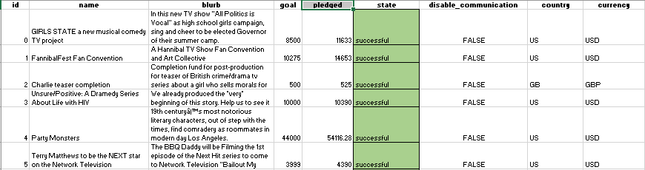
Homework #1 - Introduction
More information to come on Wednesday!

Slide 115
Questions / Discussion
Notes:
It’s important to keep in mind why you joined this class. Let’s talk about your goals.

